Slide 1

IBM Advance Data Science Capstone Project
Breast Cancer Prediction
Aymen Ragguem
Junior Data Scientist

Slide 2
OUTLINES
DOMAIN BACKGROUND
PROBLEM STATEMENT
DATA SET - USE CASE
DATA EXPLORATION
DATA CLEANSING - DATA AGGREGATION
MODEL DEFINITION AND TRAINING
MODEL EVALUATION - HYPER PARAMETER TUNING
2

Slide 3
DOMAIN BACKGROUND

Slide 4
DOMAIN BACKGROUND
Breast cancer is the most common malignancy among women, accounting for nearly 1 in 3 cancers diagnosed among women in the United States, and it is the second leading cause of cancer death among women. Breast Cancer occurs as a results of abnormal growth of cells in the breast tissue, commonly referred to as a Tumor. A tumor does not mean cancer - tumors can be benign (not cancerous), pre-malignant (pre-cancerous), or malignant (cancerous). Tests such as MRI, mammogram, ultrasound and biopsy are commonly used to diagnose breast cancer performed.
4
4

Slide 5
DOMAIN BACKGROUND
Breast Cancer Prediction : The features of the dataset are computed from a digitized image of a fine needle aspirate (FNA) of a breast mass. They describe characteristics of the cell nuclei present in the image.
5
5

Slide 6
PROBLEM STATEMENT

Slide 7


PROBLEM STATEMENT
Given breast cancer results from breast fine needle aspiration (FNA) test (is a quick and simple procedure to perform, which removes some fluid or cells from a breast lesion or cyst (a lump, sore or swelling) with a fine needle similar to a blood sample needle). Since this build a model that can classify a breast cancer tumor using two training classification:
1= Malignant (Cancerous) - Present
0= Benign (Not Cancerous) -Absent
7

Slide 8
PROBLEM STATEMENT
Since the labels in the data are discrete, the predication falls into two categories, (i.e. Malignant or benign). In machine learning this is a classification problem.
Thus, the goal is to classify whether the breast cancer is benign or malignant and predict the recurrence and non-recurrence of malignant cases after a certain period. To achieve this we have used machine learning classification methods to fit a function that can predict the discrete class of new input.
8

Slide 9
DATA SET - USE CASE

Slide 10
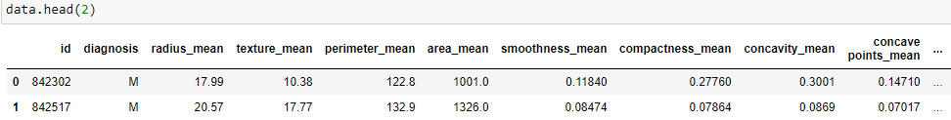
DATA SET - USE CASE
Breast Cancer dataset is available In Kaggle.com it is a csv file that contain 569 rows with 32 features.
The Breast Cancer datasets is available machine learning repository maintained by the University of California, Irvine
10

Slide 11
DATA SET - USE CASE
The Goal is to train a model with the capability to classify the diagnosis by making predictions based on the dataset
Evaluation Metrics
To validate the model and determine its performance, the actual information from the data will be compared with the predictions, and the Recall and precision will be analyzed. Those two are calculated by looking at four things: True positive-False positive-True negative -False negative
Project Design
Data Preprocessing : Will check the data and prepare it by removing data input errors, missing values. Also checking for outliers and removing 10% - 25% or the leading and tailing data narrow the outliers
11

Slide 12
DATA SET - USE CASE
Data Processing : Will visualize the data and check the correlation and try to find pattern first visually. After that one of the supervised learning Algorithm will be use. It is yet uncertain whether supervised learning will be employed.
Training and Testing : will split the data and do 70% training and 30% for testing and to ensure the model is robust and we getting a result we can trust a cross validation will be applied.
12

Slide 13
DATA EXPLORATION

Slide 14
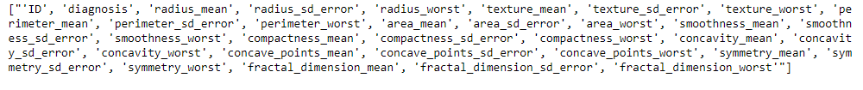
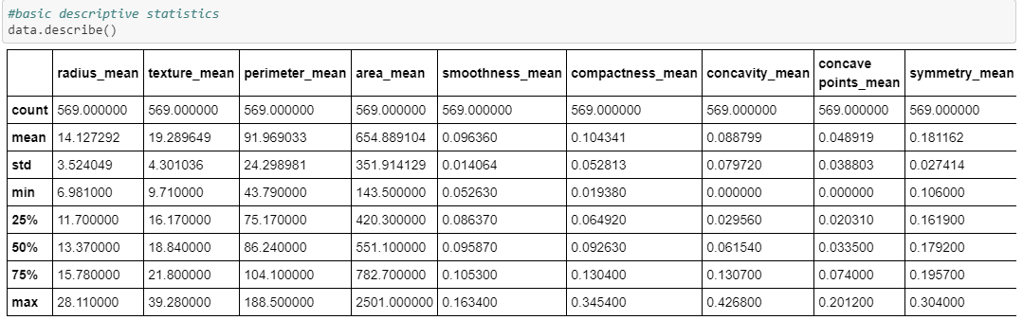
DATA EXPLORATION
Features description:
There are two approached used to examine the data using: Descriptive statistics and Visualization
Data description
14

Slide 15
DATA EXPLORATION
Features description:
There are two approached used to examine the data using: Descriptive statistics and Visualization
Data description
15

Slide 16
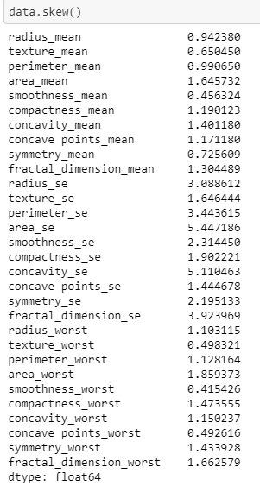
DATA EXPLORATION
Features description:
The skew result show a positive (right) or negative (left) skew.
Values closer to zero show less skew. From the graphs, we can see that radius_mean, perimeter_mean, area_mean, concavity_mean and concave_points_mean are useful in predicting cancer type due to the distinct grouping between malignant and benign cancer types in these features. We can also see that area_worst and perimeter_worst are also quite useful.
16

Slide 17
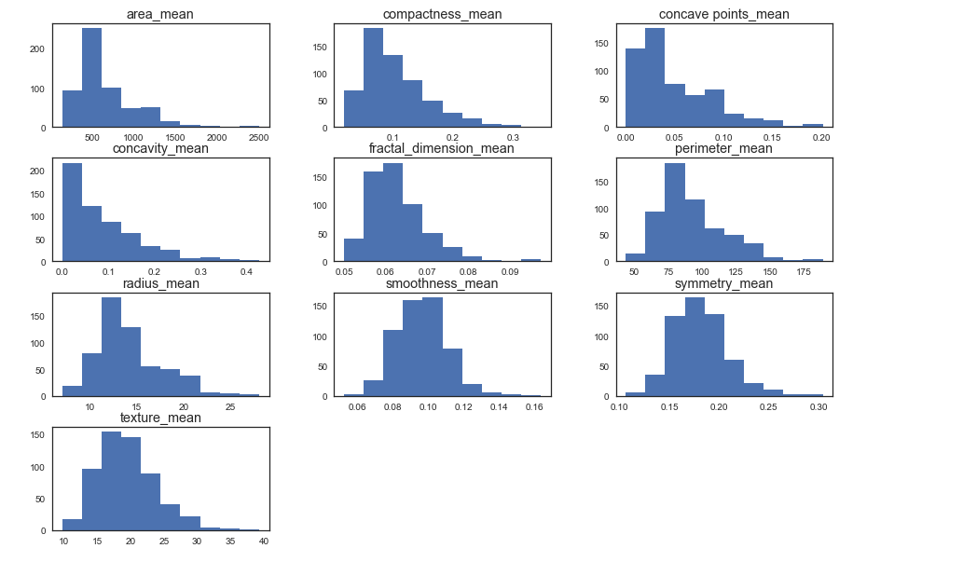
DATA EXPLORATION
Visualise distribution :
Histogram the "_mean" suffix designition
17

Slide 18
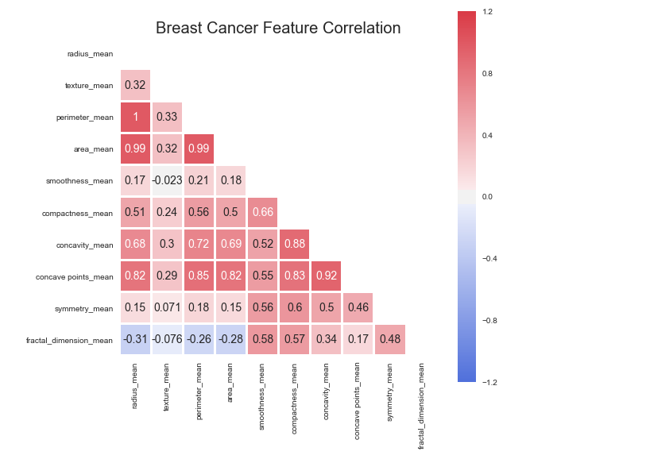
DATA EXPLORATION
Features Correlation:
Histogram the "_mean" suffix designition
We can see strong positive relationship exists with mean values paramaters between 1-0.75;
18

Slide 19
DATA CLEANSING
DATA AGGREGATION

Slide 20
DATA CLEANSING
DATA AGGREGATION
Label Encoding:
I assign the 30 features to a NumPy array X, and transform the class labels from their original string representation (M and B) into integers
Split data into training and test sets:
Split the available data into a training set and a testing set. (70% training, 30% test)
Features Standardisation
Feature decomposition using Principal Component Analysis( PCA):
It makes sense to use one of the dimensionality reduction methods to try to use as many features as possible and maintain as much information as possible
20

Slide 21
MODEL DEFINITION AND TRAINING

Slide 22
MODEL DEFINITION AND TRAINING
Predictive model using Support Vector Machine (SVM)
Support vector machines (SVMs) learning algorithm will be used to build the predictive model. SVMs are one of the most popular classification algorithms, and have an elegant way of transforming nonlinear data so that one can use a linear algorithm to fit a linear model to the data (Cortes and Vapnik 1995)
Important Parameters
The important parameters in kernel SVMs are the
Regularization parameter C,
The choice of the kernel,(linear, radial basis function(RBF) or polynomial)
Kernel-specific parameters.
22

Slide 23
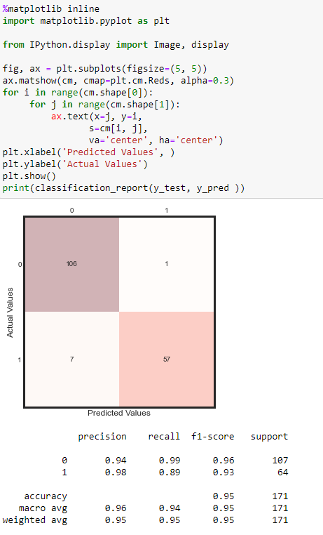
MODEL DEFINITION AND TRAINING
Predictive model using Support Vector Machine (SVM)
Results:
Results: Accuracy
test: 0.95
23

Slide 24
MODEL DEFINITION AND TRAINING
Support vector machines (SVMs) learning algorithm will be used to build the predictive model. SVMs are one of the most popular classification algorithms, and have an elegant way of transforming nonlinear data so that one can use a linear algorithm to fit a linear model to the data (Cortes and Vapnik 1995)
Important Parameters
The important parameters in kernel SVMs are the
Regularization parameter C,
The choice of the kernel,(linear, radial basis function(RBF) or polynomial)
Kernel-specific parameters.
24

Slide 25
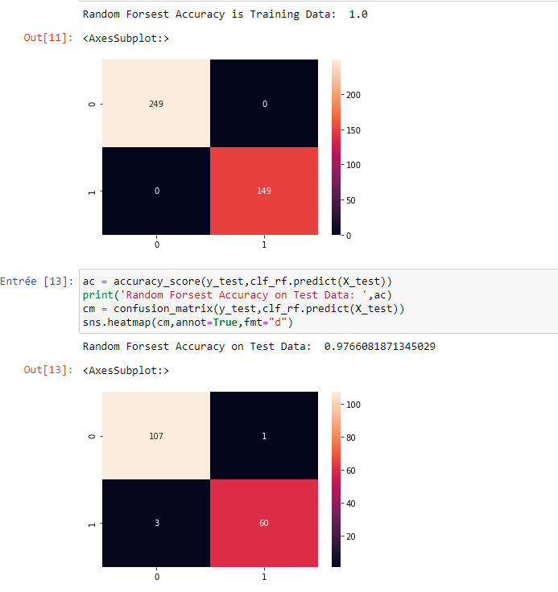
MODEL DEFINITION AND TRAINING
2. Predictive model using using Random Forest Classification
Results: Accuracy
test: 0.97
25

Slide 26
MODEL EVALUATION - HYPER PARAMETER TUNING

Slide 27
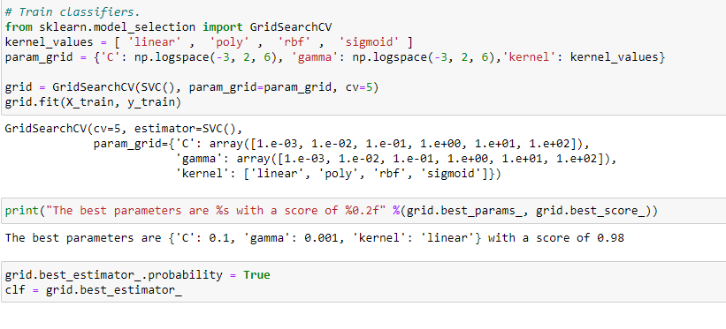
MODEL EVALUATION - HYPER PARAMETER TUNING
Optimizing the SVM Classifier
Machine learning models are parameterized so that their behavior can be tuned for a given problem. Models can have many parameters and finding the best combination of parameters can be treated as a search problem. In this notebook, I aim to tune parameters of the SVM Classification model using scikit-learn.
27

Slide 28
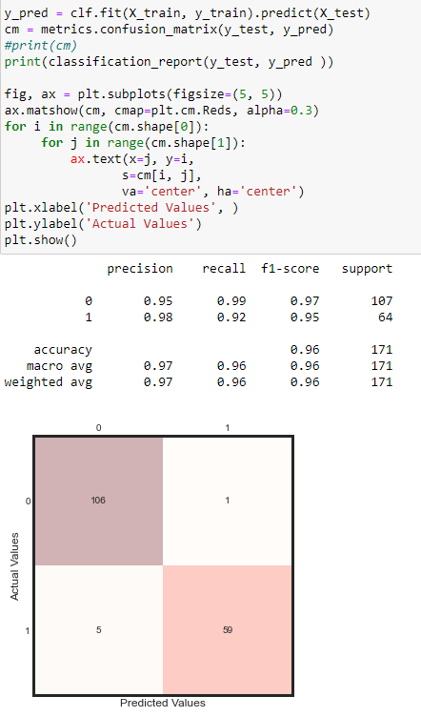
MODEL EVALUATION - HYPER PARAMETER TUNING
Optimizing the SVM Classifier
3. Predictive model using Support Vector Machine (SVM)
Results:
Results: Accuracy
test: 0.98
28

Slide 29
CONCLUSION
Model | Accuracy
Support Vector Machine (SVM) | 0.98
Random Forest | 0.97
Based on the above observations the Random Forest Model Support Vector Machine (SVM) and are performing well.
29

